Slide 1

Safety Meeting
9 June 2015

Slide 2
Agenda
Welcome
BoD Updates/Aircraft Status
Safety Subject—Mid-Air Collison Avoidance
Questions/Comments

Slide 3
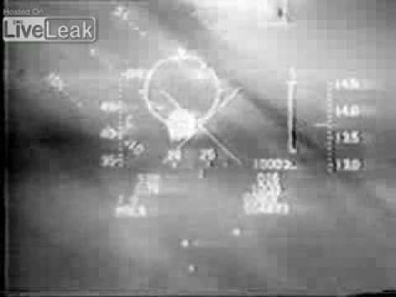
Mid-Air Collison Avoidance
https://www.youtube.com/watch?v=OMAkciwiPL0
Notes:
https://www.youtube.com/watch?v=OMAkciwiPL0

Slide 4
Tonight, We Will Cover
Statistics
Why Airplanes Hit Each Other
Strategy & Tactics to Avoid Mid-Airs
Mishaps
Notes:
Scanning Techniques
Help

Slide 5
Statistics
Pilot Reported NMACs by Hazard Type
Notes:
Critical = A situation where collision avoidance was due to chance, rather than an act on the part of the pilot. Less than 100 feet of aircraft separation would be considered critical.
Potential = An incident that would probably have resulted in a collision if no action had been taken by either pilot. Less than 500 feet would usually be required in this case.
When direction and altitude would have made a midair collision improbable regardless of evasive action taken.
No determination could be made due to insufficient evidence or unusual circumstances, or because incident is still under investigation.

Slide 6
Statistics
A Real Threat? 10-20 per year since 2000…
87% occur in VFR conditions
42% occur during descent/approach
Primarily within 10nm of the airport
Also, mostly on Weekends
Mostly at Non-towered airports
Below 1,000 ft
Mostly struck in Rear Quarter
Notes:
The 2010 Nall Report on aviation safety sheds light on GA midair collisions, which occur most often in good weather. In fact, 87% of them happen in day VFR conditions. They account for nearly 42% of descent/approach accidents, and most often occur near the airport. Most aircraft involved in midair collisions are engaged in recreational flying, and not on any kind of flight plan. Collisions happen mostly on weekends, with the vast majority occurring near nontowered airports and below 1,000 feet. They occur mostly from behind, or at a slight angle, not head-on.
Since 2000, the number of midair collisions annually has remained in the teens and 20s, though 2009 was an unusually quiet year with 10 of them. Compared to other accident causes, midair collisions are relatively rare, but when they do occur, they’re almost always fatal (seven out of the 10 in 2009). Given the lethality of these types of accidents, all pilots should have traffic avoidance on their minds. Today, we have two methods of avoiding midair collisions; one is the “see and avoid” concept, and the second is the Traffic Collision Avoidance System (“TCAS” for short).

Slide 7
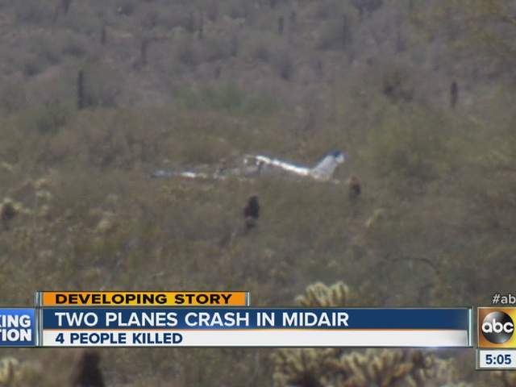
Also, Mostly Fatal

Slide 8
Why Airplanes Hit Each Other
Blind Spots
High Density Traffic Areas
FAA Rules designed to “See and Avoid” do not always work
Complacency

Slide 9
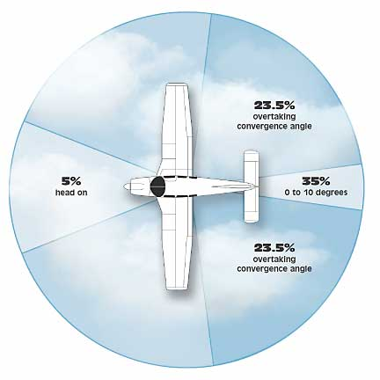
Where Are We Vulnerable?

Slide 10
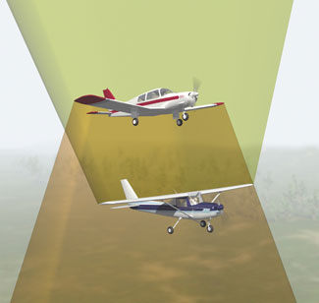
Where Are We Vulnerable?

Slide 12
Collision Geometry
T1
T0
T1
The faster aircraft has the slower aircraft in its primary “Scan Volume” for much longer than the slower aircraft; at co-speed both are outside of this visual area.
T0

Slide 13
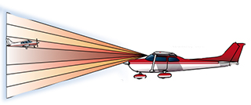
Scan Volume

Slide 14
Strategy & Tactics to Avoid Mid-Airs
Plan Ahead
See and Avoid
Clear
Communicate
Squawk
Be Seen

Slide 15
Military Aircraft
Caution near the Instrument Pattern ILS base, dog-leg, and final
Avoiding high traffic areas, Alert Areas (When HOT), MOAs, Aux Fields, MTRs
Traffic conflicts often occur while one aircraft is transiting the flight path of another
Talk to Patuxent Approach
Notes:
From Luke AFB flyer:
ILS base, dog-leg, and final for Rwy XX is the area with the highest amount of traffic conflicts. Grand Avenue is a popular route for civil traffic to fly VFR into and out of local airports. This continues to be the area of concern of most F-16 pilots. The frequency of near midair's along the recovery routing is to Rwy XX is greater than any other area in the Phoenix airspace.
The second highest potential for a midair is in the instrument pattern for Aux-1, the closed auxiliary airfield 13 NM northwest of Luke AFB.
5. Where should I fly to avoid hitting a F-16?
Avoiding high traffic areas such as final for Rwy 21 and Grand Avenue will decrease the possibility of a midair greatly. Also, avoiding the alert area depicted on the sectional will keep you clear of the Aux-1 pattern. Due to emergency procedure training above Luke, over flight below 11,000' MSL is not recommended. Although MOAs are not restricted from civilian VFR traffic, they should be avoided when active (weekdays and some Saturdays) to minimize midair potential.
6. What is the best way to see an F-16 and avoid a midair collision?
The best was to see and avoid any aircraft is to use a proper scan pattern. One technique is to start at one side of the wind screen and allow your eyes to focus every 10-15 degrees. Remember to search above and below the horizon. Traffic conflicts often occur while one aircraft is transiting the flight path of another. You can also detect other aircraft by communicating with Air Traffic Control. If traveling north of Luke airspace, contact "Luke Approach" on 118.15; south of Luke contact "Luke Approach" on 125.45.

Slide 16
Scanning Techniques
Distant Focus; avoid ‘Empty Field Myopia’
Side to Side/Front to Side
Sector; Focus Every 10-15 degrees, above/below horizon
Contrast
“See with your Ears;” Listen for where traffic is reporting
Likely Places (Airways, VORTACs, Fixes)
Blind Spots
Notes:
Start at one side of the wind screen and allow your eyes to focus every 10-15 degrees. Remember to search above and below the horizon. Traffic conflicts often occur while one aircraft is transiting the flight path of another.

Slide 17
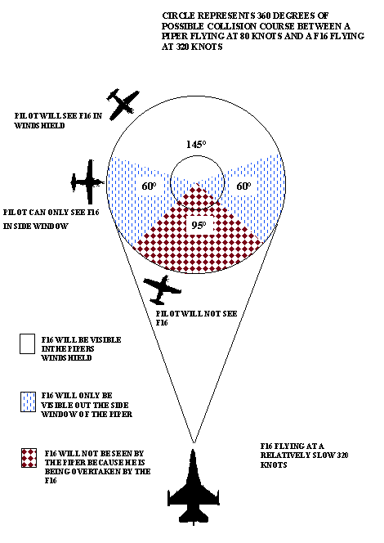

Slide 18
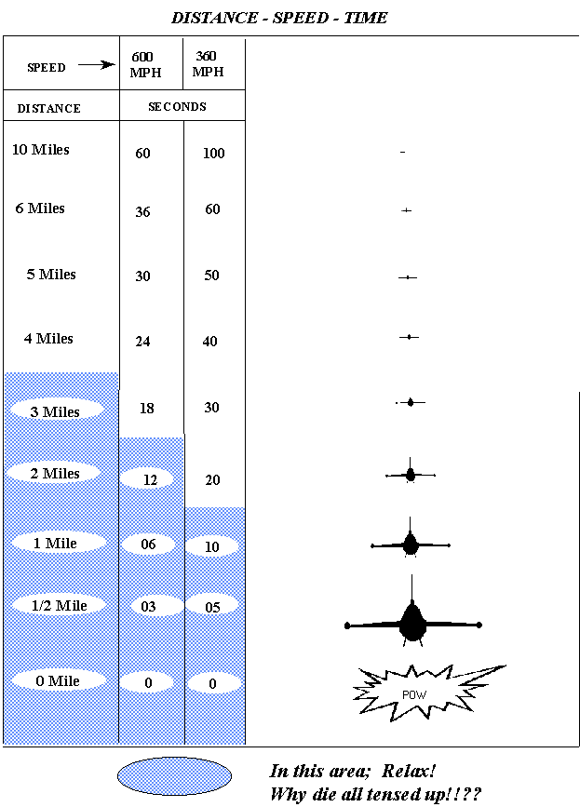

Slide 19
Help
TCAS
Flight Following/ATC
Be Seen
“Sashay”

Slide 20
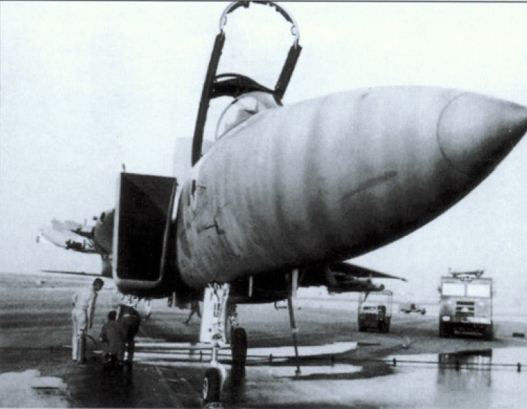
Mishaps
Notes:
Israeli F-15 flew back and landed after losing a wing in a mid-air collision with an A-4.

Slide 21
Mishaps
Military Fighters—High speeds and types of operations
Frederick accident, 2014—Dissimilar aircraft in traffic pattern, not in sight of each other

Slide 22
http://www.ryot.org/video-skydivers-gopro-captures-fiery-mid-air-collision-between-two-planes/456757
https://www.youtube.com/watch?v=Mj4J0t3iE7s
Notes:
Skydivers
AT-38B on low level route

Slide 23
Resources
http://www.avweb.com/news/airman/midair_collision_math_208325-1.html
http://www.aopa.org/Pilot-Resources/Safety-and-Technique/Accident-Analysis/Accident-Statistics/EPilot-Reports/ePilot-ASF-Accident-Reports-Midair-Collision
http://www.seeandavoid.org/

Slide 24
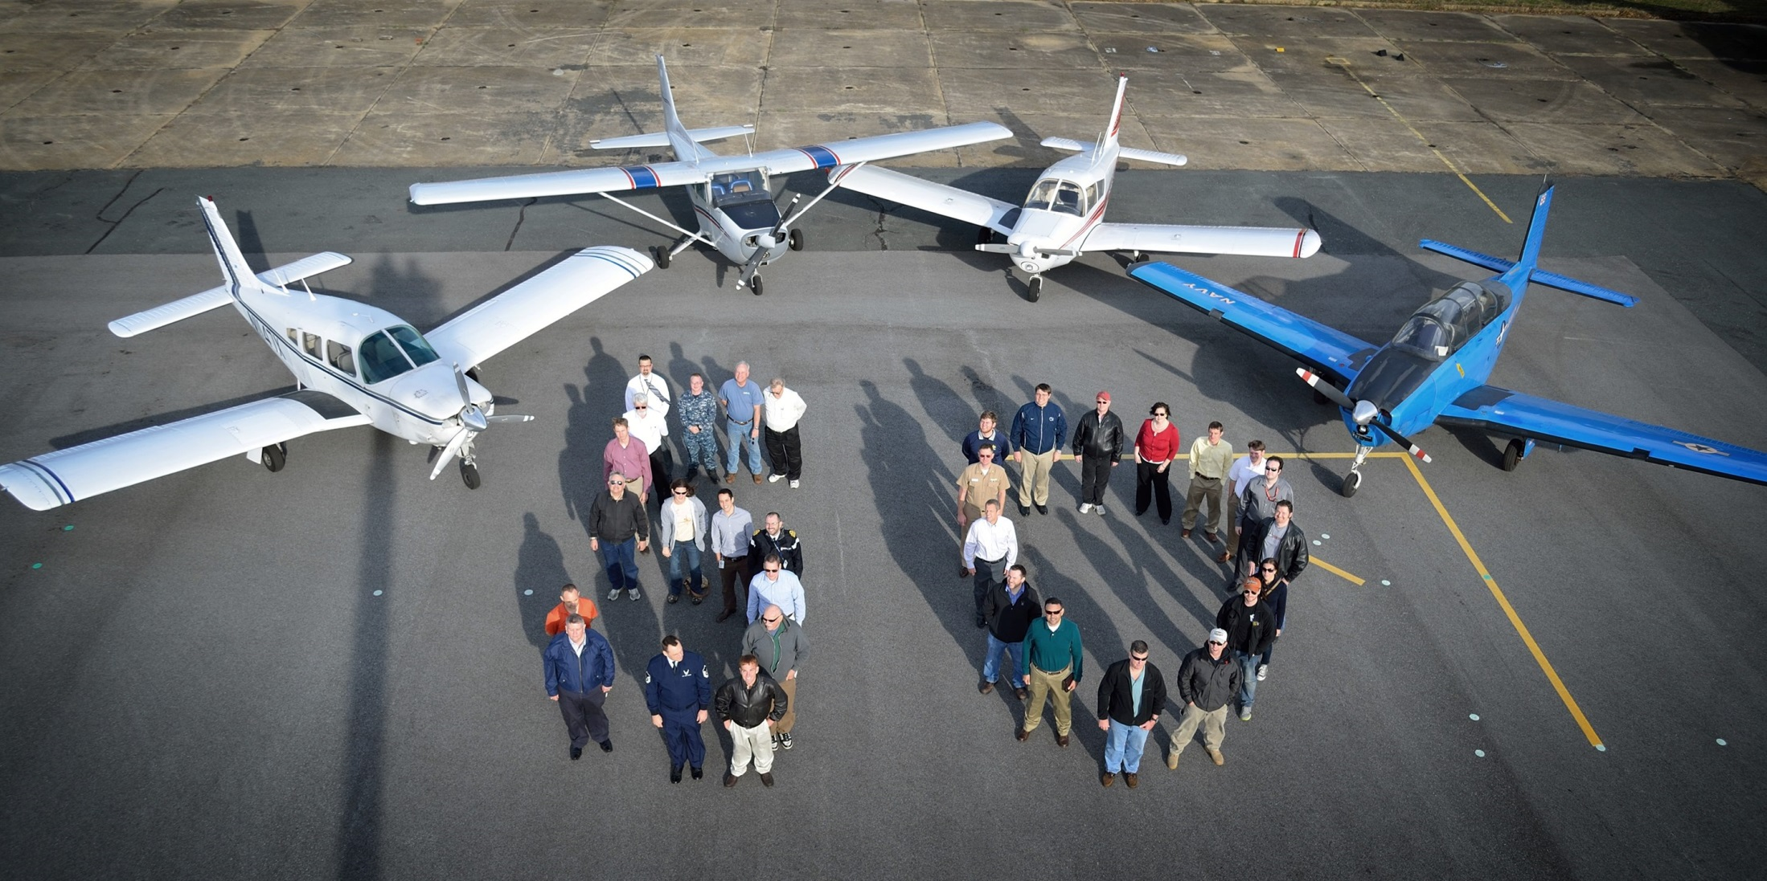
Questions/Comments

Slide 25
Preview—Next Safety Meeting
TBD

Slide 26
Future Safety Meeting Subjects
Local Flying Area Problems
Mid-Air Collision Prevention
Seasonal Flying Hazards (including Wx and Bird Migration)
Light Aircraft Maintenance and Potential Problem Areas
Mishap Reports
Wake Turbulence, Thunderstorms, Microbursts, Crosswinds, Flight Planning and Fuel Management
Lost Pilot and other Emergency Procedures
Spatial Disorientation, Survival, and Hypoxia
Medication and Self-Medicating Hazards
Mountain flying
Cross-Country Flying

