Slide 1
Patuxent River Navy Flying Club Monthly Safety Briefing December 13, 2016
Dave Kirk
PRNFC Safety Officer

Slide 2
Safety Topic

Slide 3
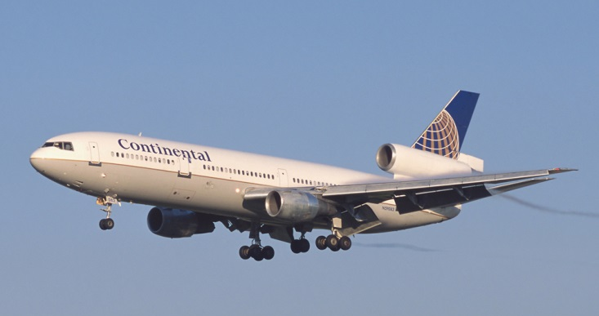
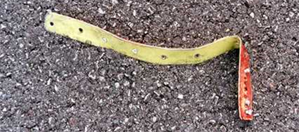
Introduction
July 25, 2000: A Continental Airlines DC-10 took off from Paris Charles de Gaulle heading for Newark, New Jersey. During the takeoff, a titanium alloy strip (part of the engine cowl, identified as a wear strip) that was about 17” long, 1” wide and 0.05” thick detached from the #3 engine onto the runway.

Slide 4
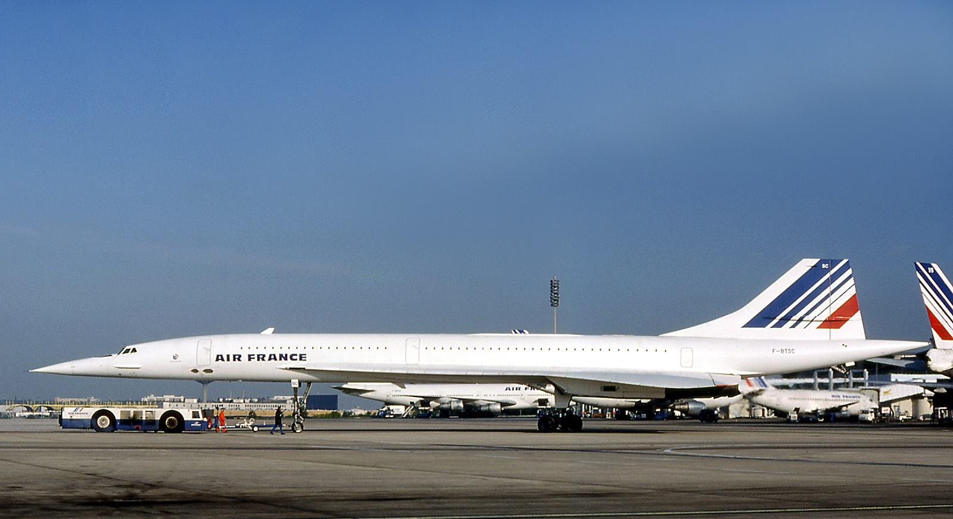
Mishap Aircraft
Five minutes later, Air France Flight 4590, an Aérospatiale-BAC Concorde on a scheduled international flight to New York City, began its takeoff roll on the same runway.

Slide 5
Mishap Sequence
A few seconds after passing through V1 ~170kts, the Concorde’s #2 main landing gear tire passed over the wear strip that had fallen from the DC-10.
The tire disintegrated, resulting in large segments of it striking the underside of the left wing. This damaged the #5 fuel tank, causing a 32cm sq segment of the tank to separate from the underside of the wing, inboard & forward of the left engine inlets. Massive amounts of fuel began leaking through the hole.
The fuel ignited instantly, causing #1 & 2 engines to malfunction with loss of thrust and a drift to the left. The pilot flying rotated at 200kts passing over the left side of the runway.

Slide 6
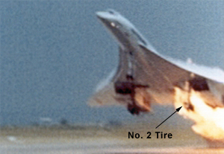
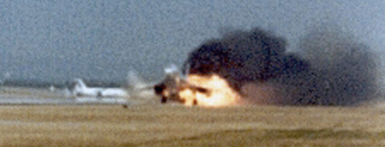
Flight 4590 at Rotation

Slide 7
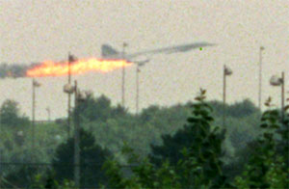
Mishap Sequence
The fire warning system for the #2 engine sounded a few seconds after lift off, followed by it being shut down by the crew. They attempted but were unable to raise the landing gear.
The plane remained at an airspeed of approximately 200 kts, an altitude of 200 feet, and was unable to accelerate or climb.
Approximately 90 seconds from the beginning of the takeoff, the #1 engine failed, resulting in the plane crashing into a hotel, killing all 109 passengers and crew on board, 4 persons on the ground, and injuring six.

Slide 8
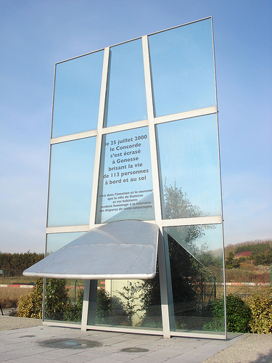

Slide 9
FOD Defined
Foreign Object Damage (FOD): any object, live or not, located in an inappropriate location in the aviation environment that has the capacity to injure personnel and damage aircraft.
FOD creates safety hazards and can ultimately impact safe operations.
FOD has been part of accidents and unscheduled maintenance reports since the earliest days of flight. Propeller nicks, tire damage, and fabric tears go way back. Modern jet aircraft are particularly susceptible to FOD due to engine intakes and high speed.

Slide 10
Examples of FOD
FOD includes loose hardware, tools, parts, pavement fragments, catering supplies, building materials, rocks, sand, pieces of luggage, pens, coins, badges, hats, soda cans, paper clips, rags, trash, paperwork and even wildlife.
Anything that can find its way into an aircraft engine or flight control mechanisms is a recipe for foreign object damage.
This damage can result in anything from minor repairs to catastrophic events.

Slide 11
Watch Out for FOD
Most FOD can be attributed to poor housekeeping, facilities deterioration, improper maintenance or careless assembly, not keeping full account of hardware, tools and materials, and inadequate operational practices.
Be alert for FOD during your activities at the PRNFC, ground or flight.
Two main categories: airfield FOD and aircraft FOD

Slide 12
Airfield FOD
Can be found on parking ramps, taxiways, runways. FOD walk-downs are a way to minimize this threat.
FOD can be created in the hangar or maintenance spaces. “Clean-as-you-go” is a best practice to prevent FOD.
Be alert walking to your plane. Don’t pass FOD by, take the extra minute to pick it up and dispose of properly.
During taxi or takeoff, if you see FOD report it to ground or tower. They will send someone out to pick it up. If you have a TFOA, report it immediately.

Slide 13
Aircraft FOD
A thorough pre-flight inspection is your best defense.
Check under the pilot seats, in the footwells, on the glare shield. Check behind the rear seats.
During your walk-around, look for tools, rags, or wildlife. This could be in the engine compartment, on the aircraft surface, or in a landing gear well.

Slide 14
FOD Dirty Dozen + 1
Jewelry
Watches
Pens
Coins
Phones
Eyewear
Hearing protection
ID Badges
Water bottles
Paper
Fasteners
Personal tools
FLIP

Slide 15
If YOU find FOD…
Pick it up and report it to the PRNFC manager and Safety O.
If it looks like it is part of the plane, be sure to write it up for maintenance action or to inform the next pilot, as appropriate.

Slide 16
Summary
Minimize FOD, bring only what you need to the plane. Secure small objects in zippered pockets or containers. Account for everything after the flight.
If you lose something on the plane, look for it as best you can. If you can’t find it, write it up.
If you see something, say something to ground or tower.
The FOD you prevent makes us all safer!

Slide 17
Safety Briefing
QUESTIONS?

